Slide 1


IOT BASED AGRICULTURE CROP MONITORING SYSTEM
Presented by:
R. Durga
M. Kiruthika
C. Sathya devi
Guide:
Dr.A.S.Baby Rani M.C.A.,M.Phil.,Ph.D..,
1

Slide 2
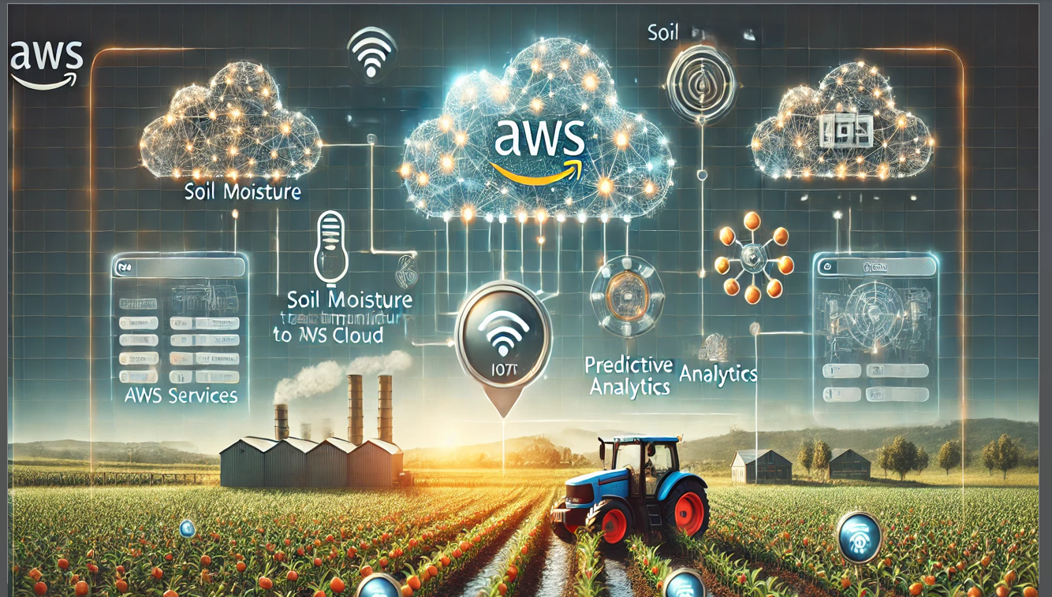
Hhjj
Temperature
Soil moisture
Soil moisture
2

Slide 3
Abstract
IoT is widely used in agriculture for various applications, improving efficiency and productivity.
Some key use cases include:
Crop Monitoring
Automated Irrigation Systems
Greenhouse Automation ,
Weather Monitoring
We are using our project for crop monitoring in agriculture. It collects data and uses it to analyze plant growth.
3

Slide 4
Requirements
Software Requirements
OS : Window 10
Web designing: HTML,CSS
Cloud Services: AWS IoT Core/ AWS Lambda/
AWS S3/ AWS DynamoDB
Development Tools : Arduino IDE
IoT Platform: Blynk Cloud
Programming Languages: Python(ML)
4

Slide 5
Hardware Requirements
Processor: AMD PRO A4-3350B APU
with Radeon R4 Graphics 2.00 GHz
Microcontroller: ESP8266/
Arduino IDE
Sensors: Soil Moisture Sensor/
DHT11 Sensor
Connectivity: Wi-Fi Module
Power Supply: 5V Power Adapter
Other Components: Jumper Wires
Breadboard
5

Slide 6
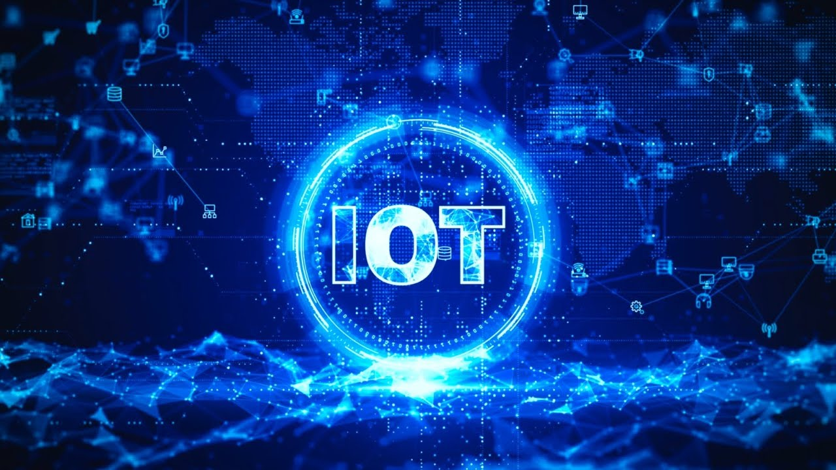
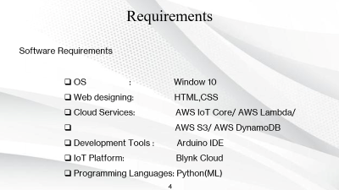
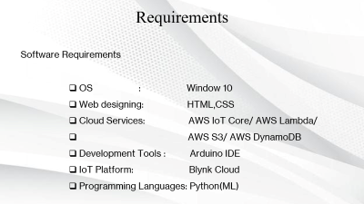
What is IoT (Internet of Things)?
The Internet of Things (IoT) refers to a network of interconnected physical devices that communicate and exchange data over the internet. These devices include sensors, microcontrollers, and cloud platforms that collect, process, and analyze data to make intelligent decisions.
6

Slide 7
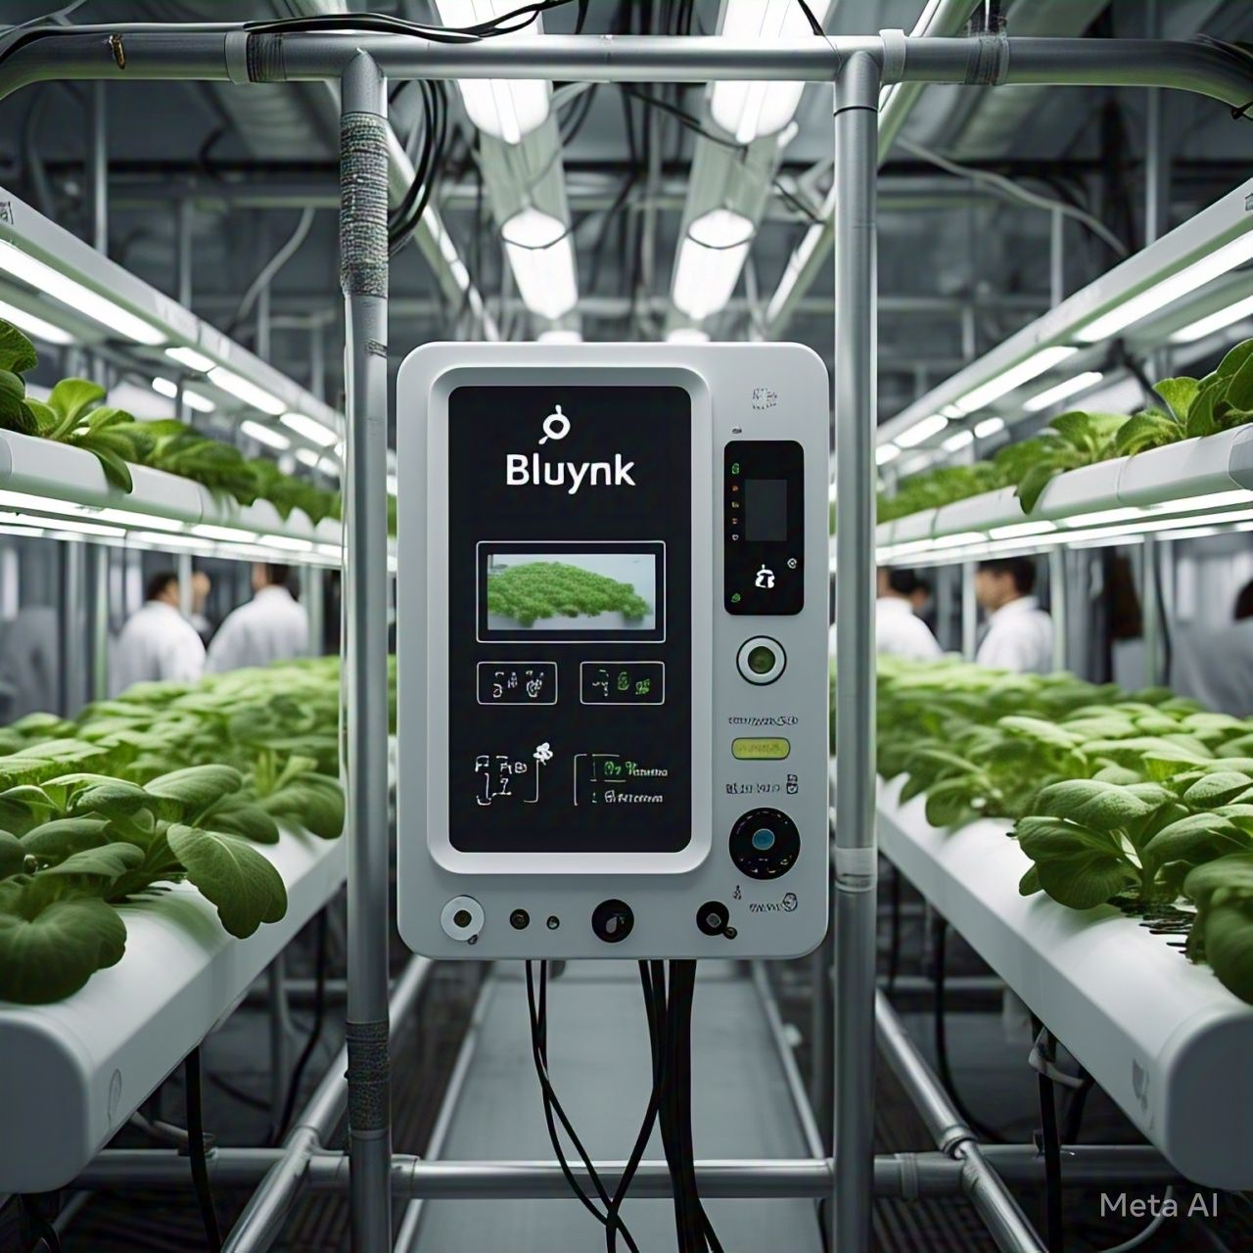
What is Blynk Cloud?
Blynk Cloud is a cloud-based IoT platform that enables real-time monitoring, control, and automation of IoT devices through the Blynk mobile app and web dashboard.
It provides a seamless way to connect microcontrollers (ESP8266, ESP32, Arduino, etc.) to the internet, allowing users to send and receive sensor data without setting up a dedicated server.
Blynk Cloud offers data visualization, remote control, automation rules, and API integrations to connect with third-party platforms like AWS, Google Cloud, and Firebase.
7

Slide 8
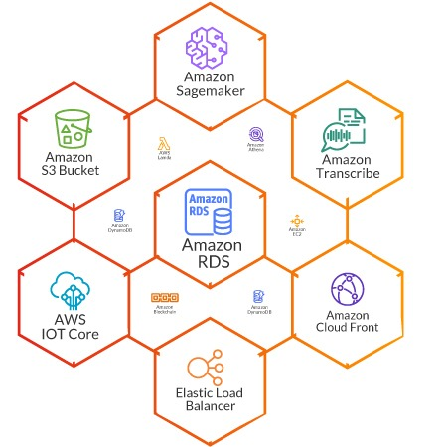
What is AWS (Amazon Web Services)?
AWS (Amazon Web Services) is a cloud computing platform that provides a wide range of services such as computing power, storage, databases, IoT management, and machine learning. It allows businesses and developers to build, deploy, and manage applications without needing physical infrastructure.
`
AWS in This Project:
In the IoT-based Crop Monitoring System, AWS is used for data processing, storage, and prediction. Here’s how AWS plays a role in this project
8

Slide 9
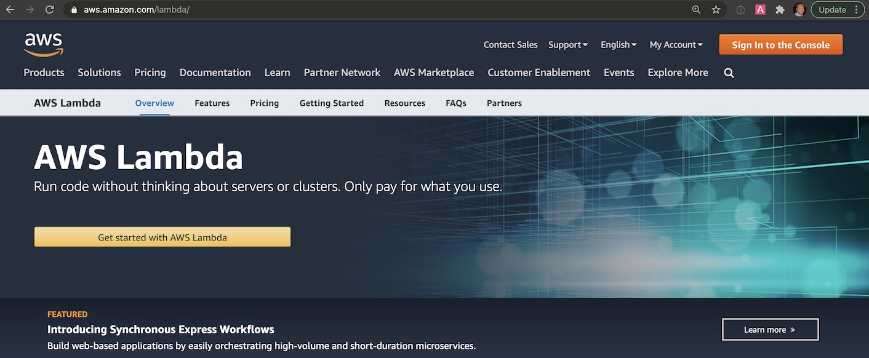
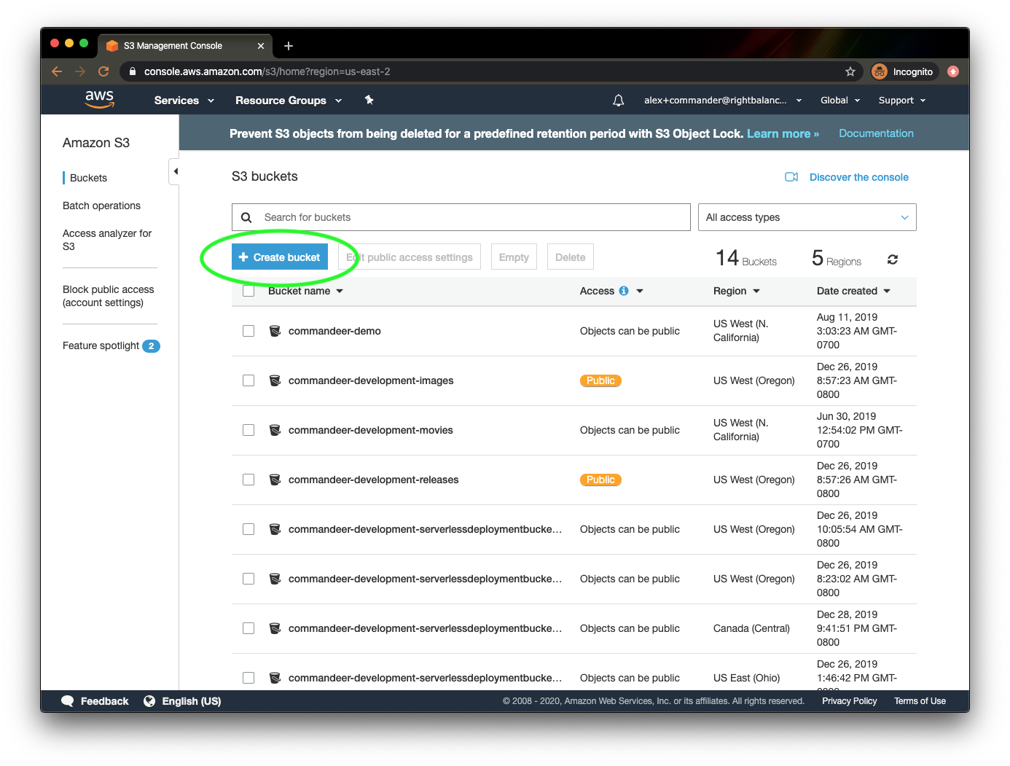
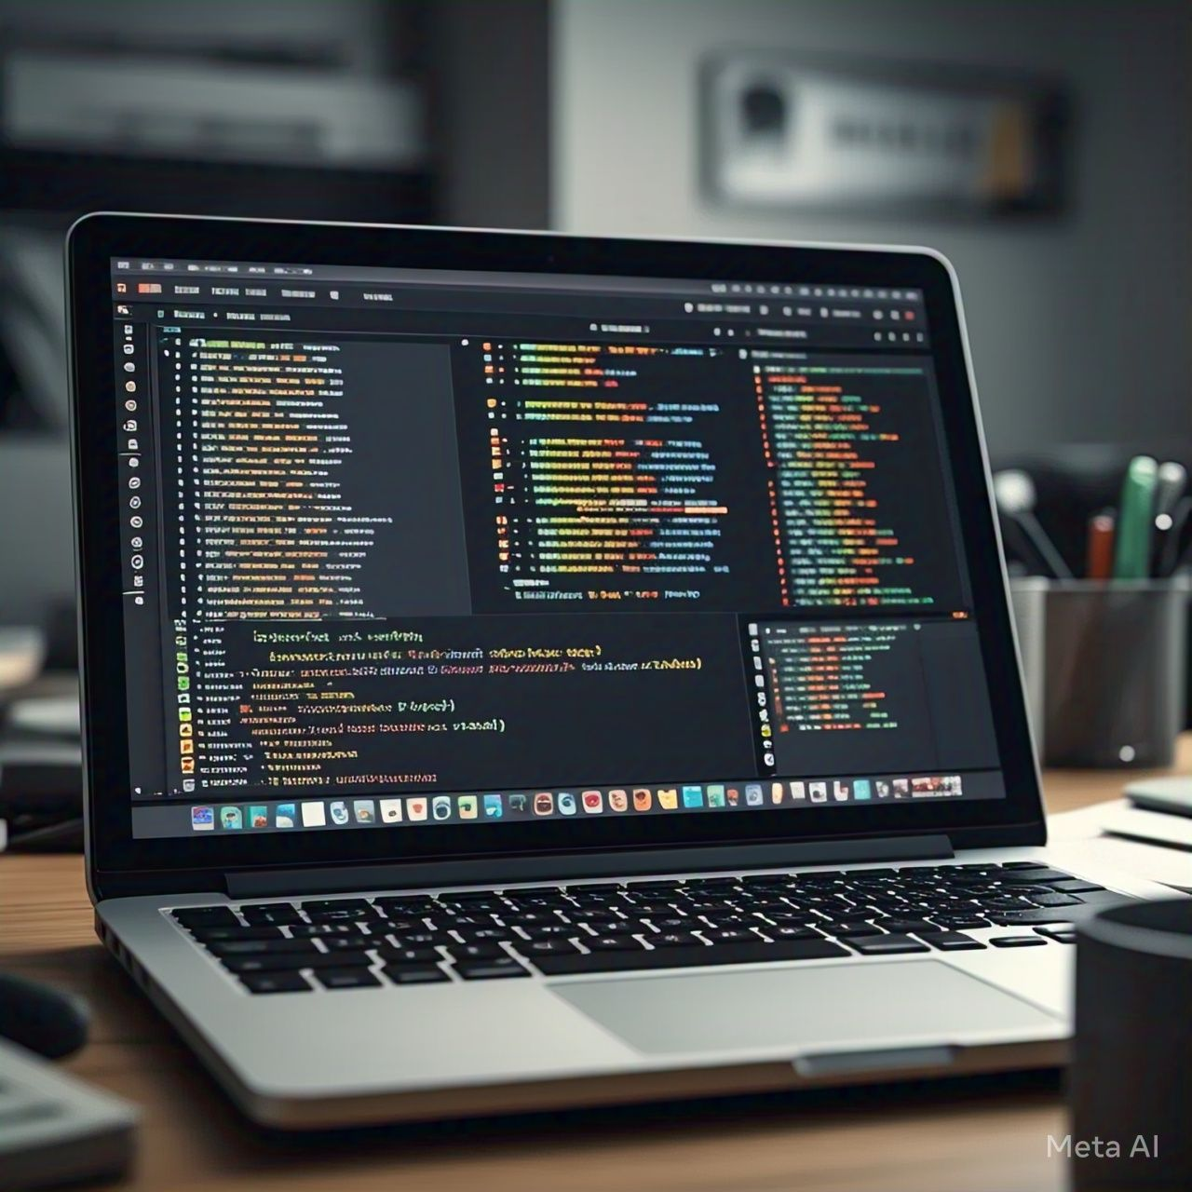
Data Processing & Prediction
AWS Lambda processes incoming data and runs prediction algorithms.
AWS DynamoDB / S3 stores historical sensor data for future analysis.
AWS Machine Learning can be used to predict plant growth based on past trends.
9

Slide 10
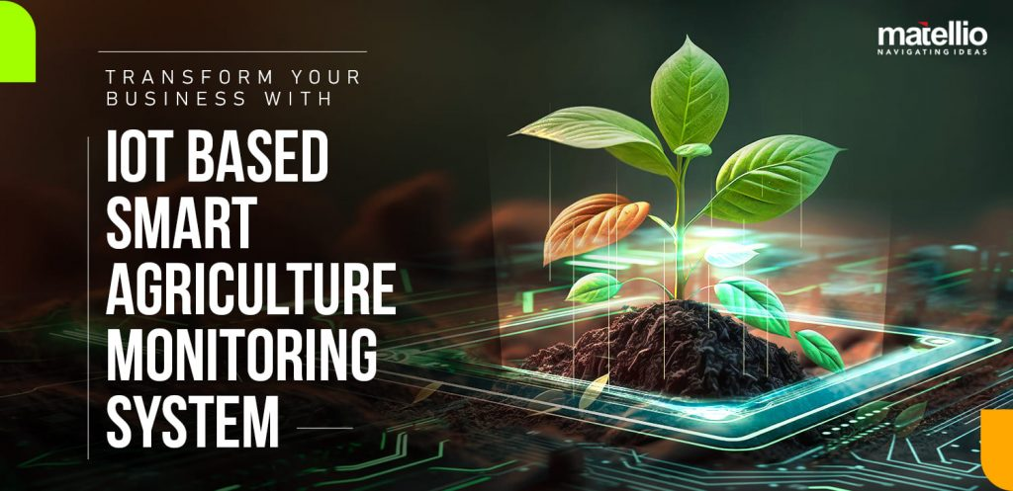
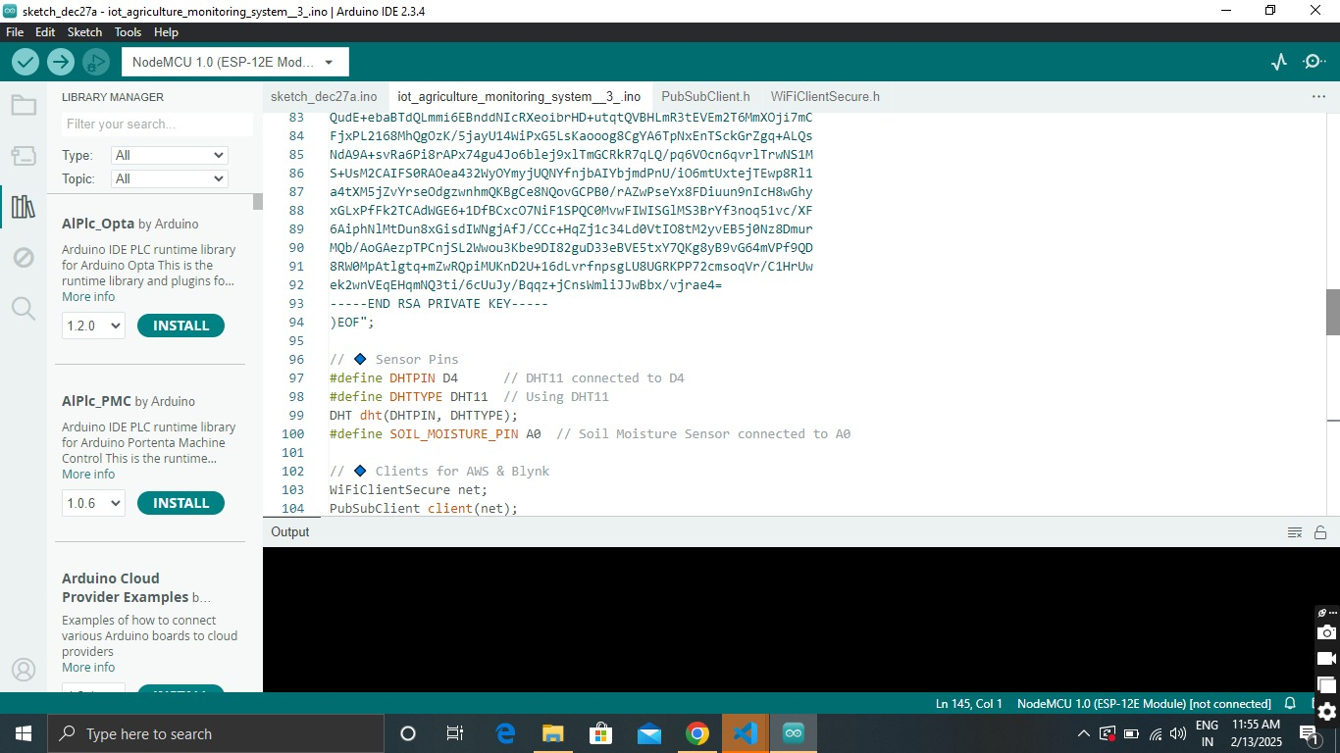
IoT in This Project
In the IoT-based Crop Monitoring System, IoT plays a crucial role in automating data collection, analysis, and remote monitoring of plant growth. Here’s how IoT is implemented in this project
10

Slide 11
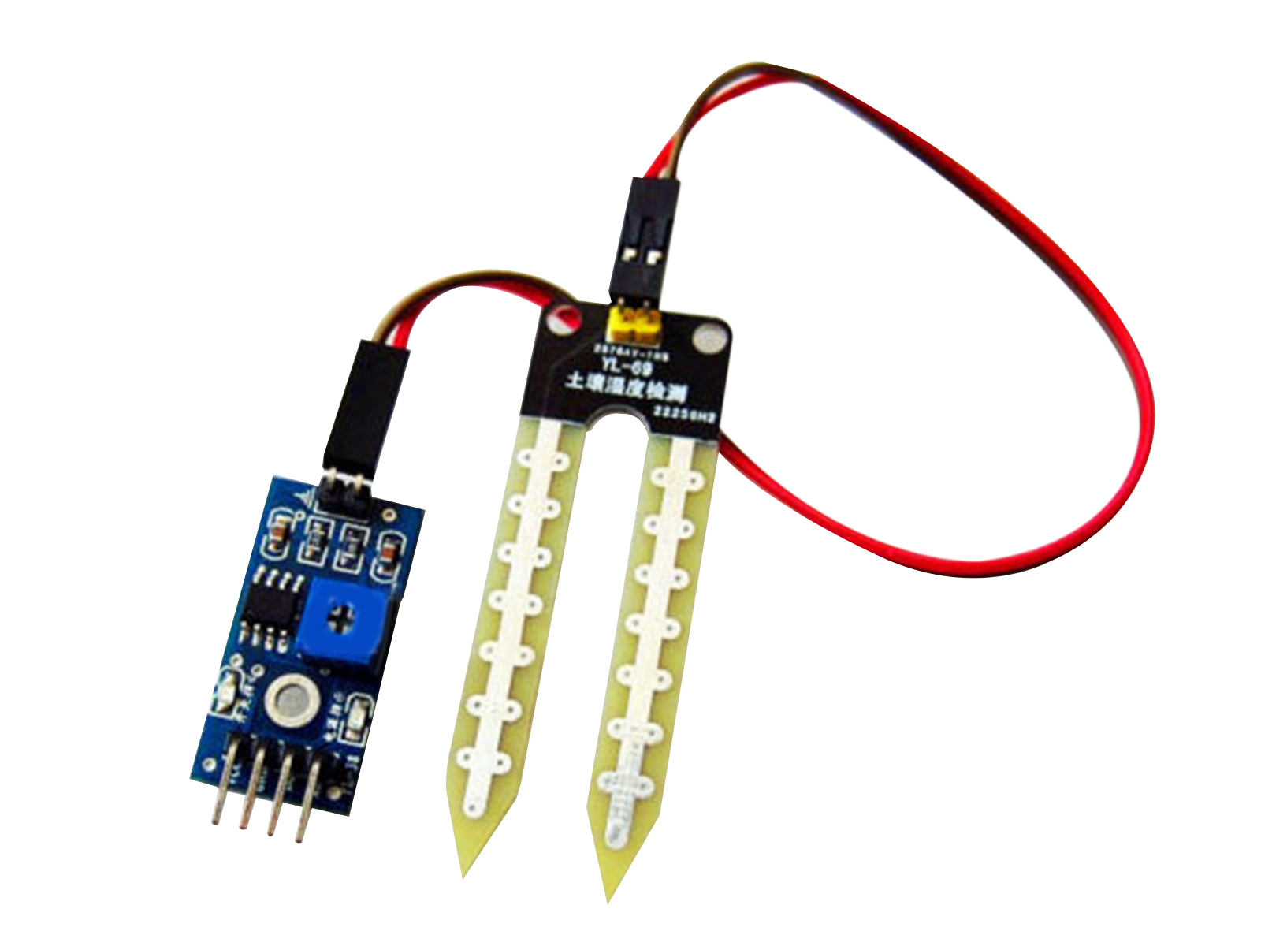
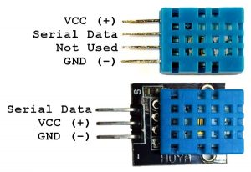
Data Collection via IoT Sensors
Soil moisture sensors measure soil moisture levels in the soil.
DHT11 sensors collect temperature and humidity data.
11

Slide 12
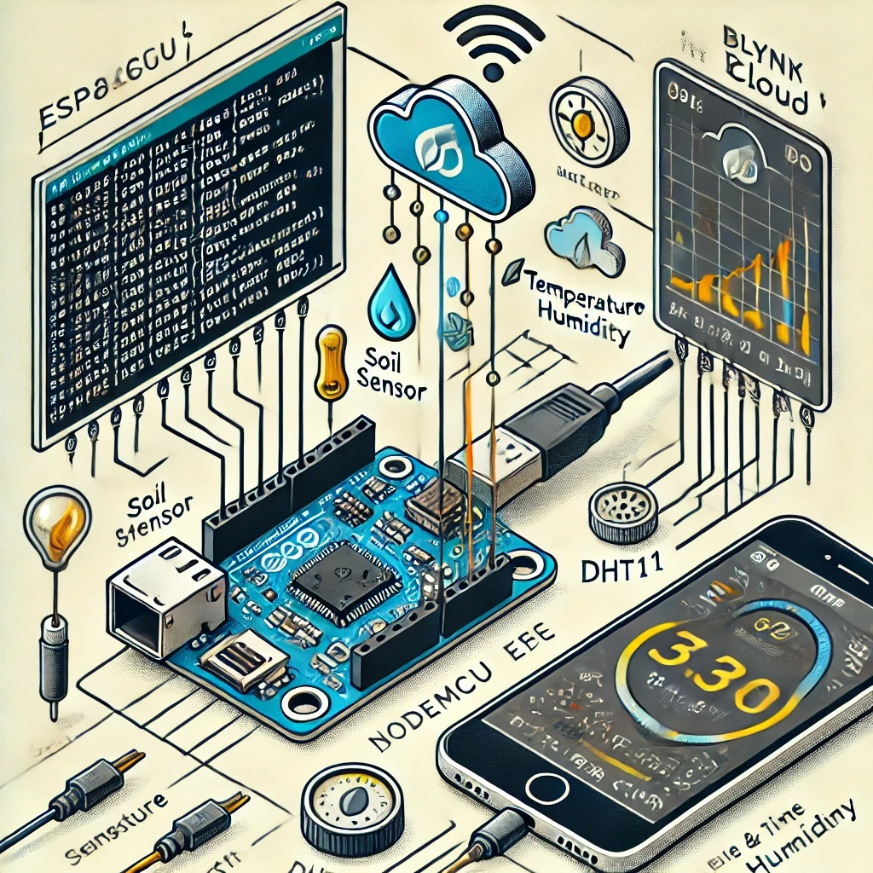
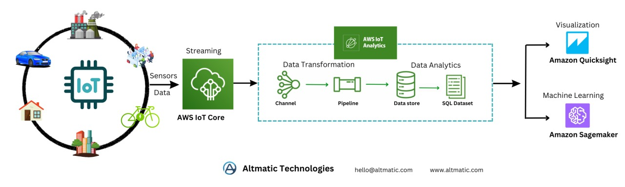
Data Transmission and Processing
The ESP8266/ESP32 microcontroller reads sensor data and sends it to Blynk Cloud for real-time monitoring.
The same data is forwarded to AWS IoT Core, where it is processed for predictive analysis.
12

Slide 13
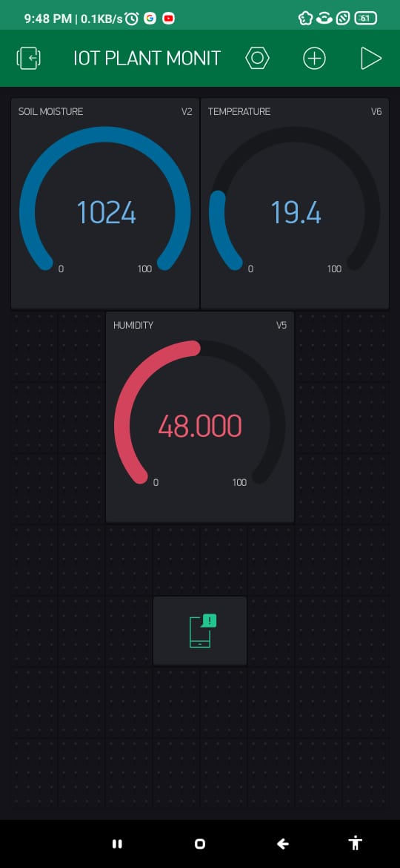
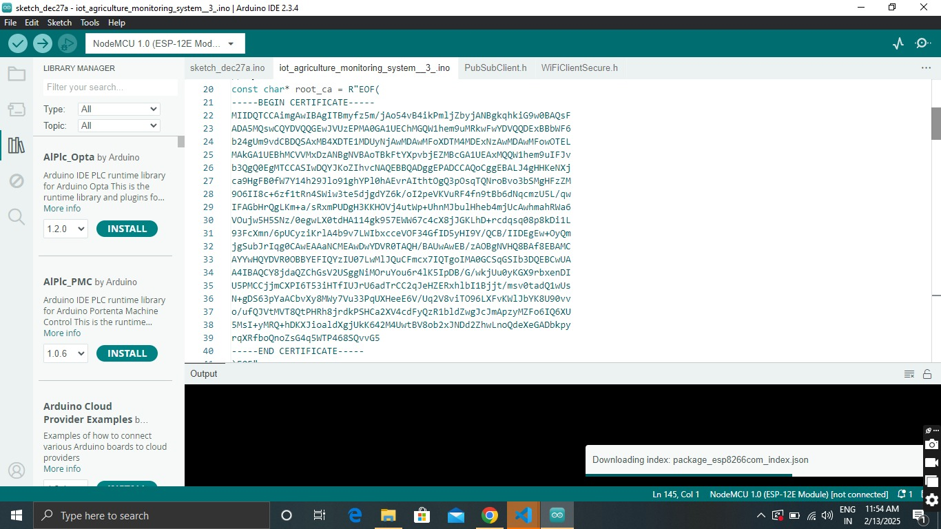
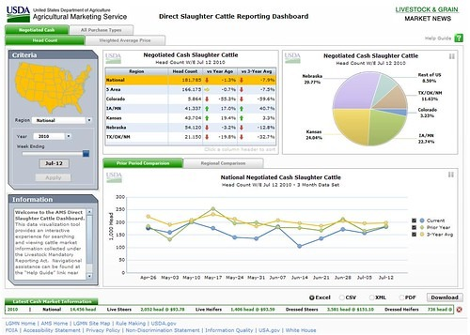
3. Data Visualization & Prediction
The Blynk app displays real-time data in percentage form for easy monitoring.
AWS uses collected data for growth prediction, and the results are displayed on a web dashboard.
13

Slide 14
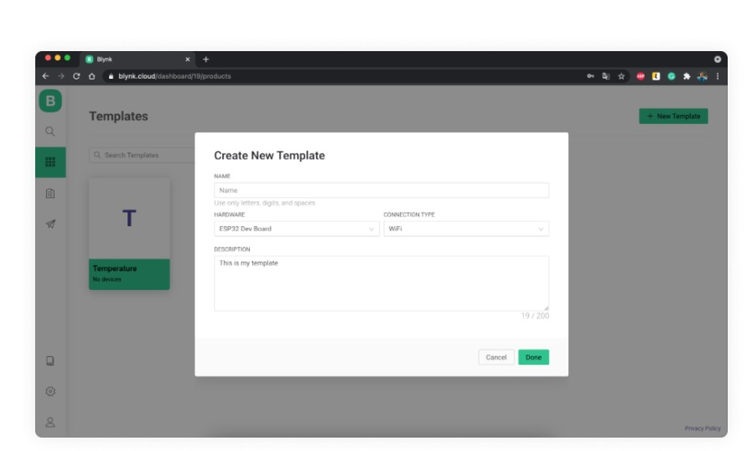
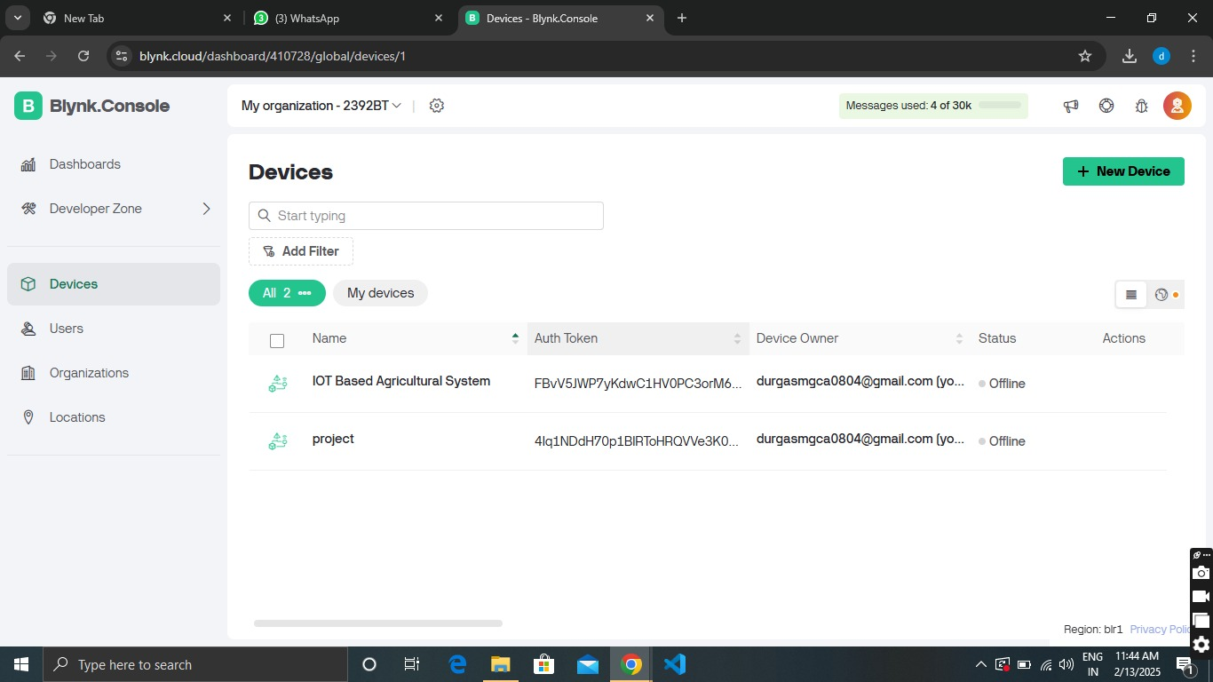
BLYNK SETUP AND ENVIRONMENT
Create a template
14

Slide 15
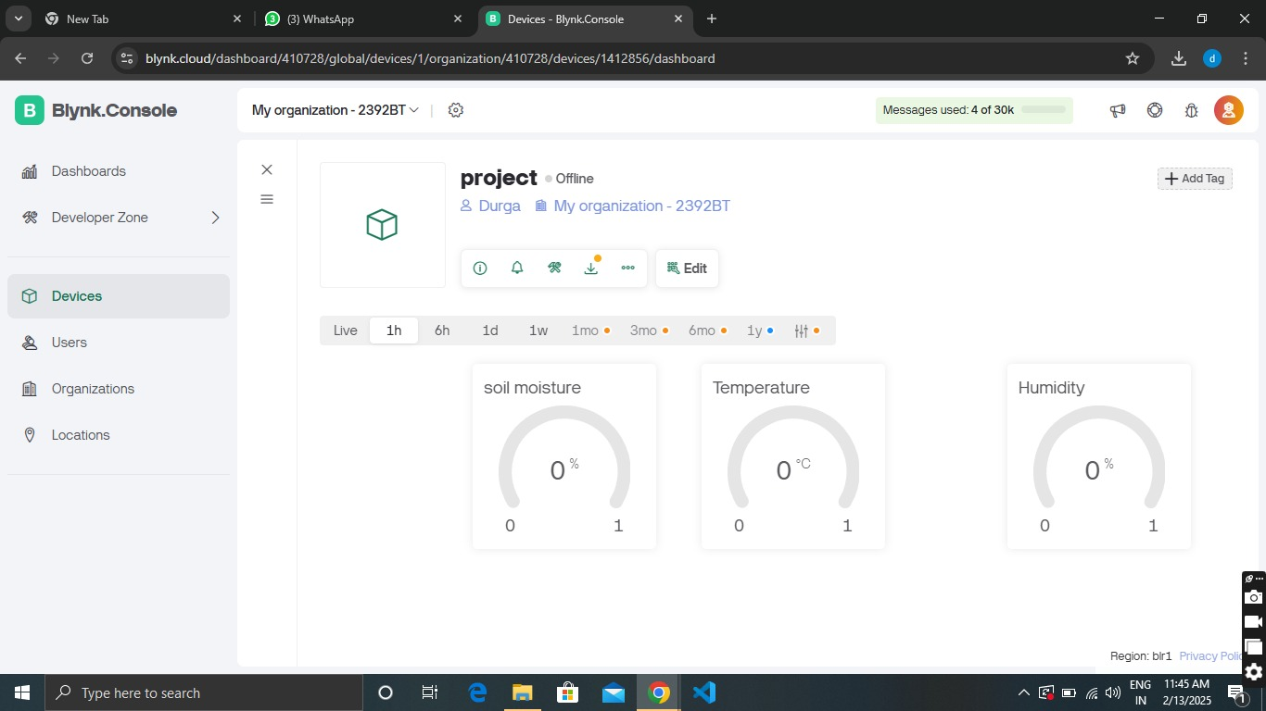
widgets
15

Slide 16
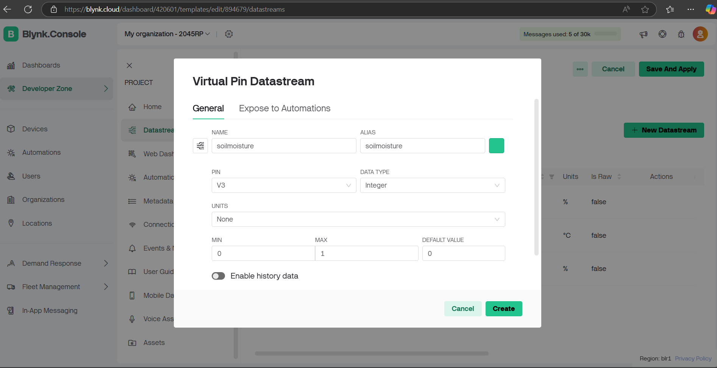
Data Streams
16

Slide 17
17

Slide 18
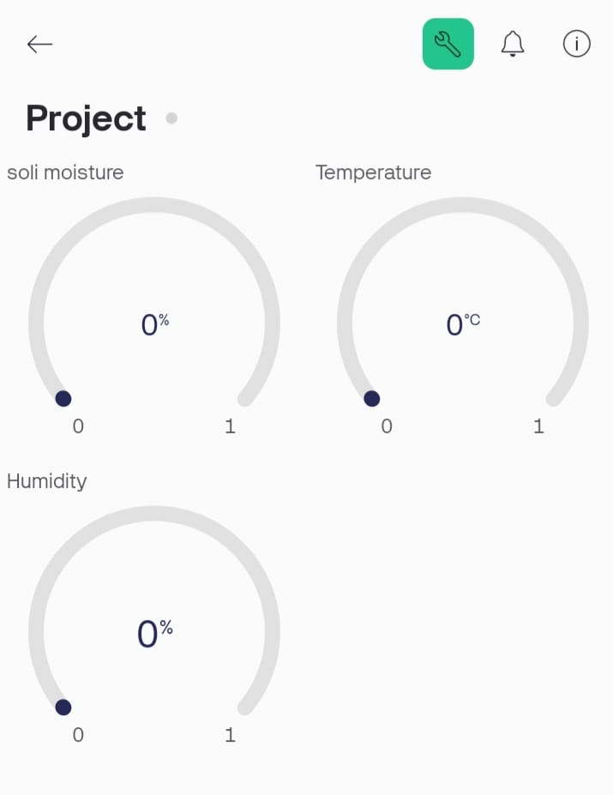
Mobile Dashboard
18

Slide 19
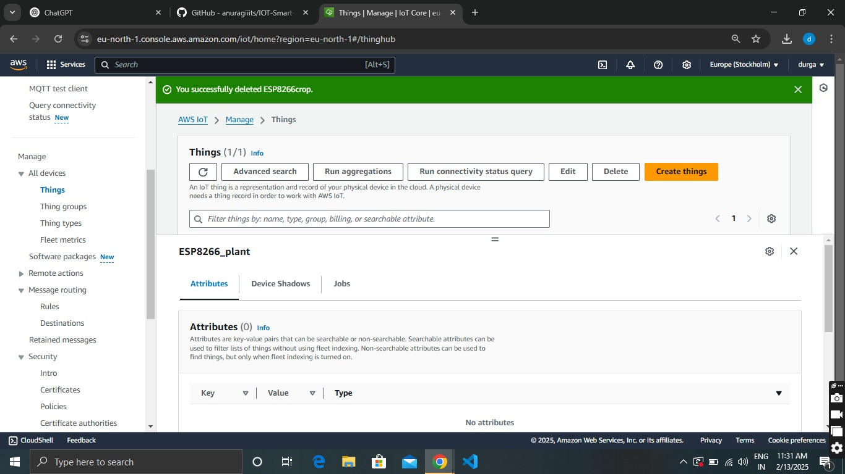
Aws setup
1. Create a things

Slide 20
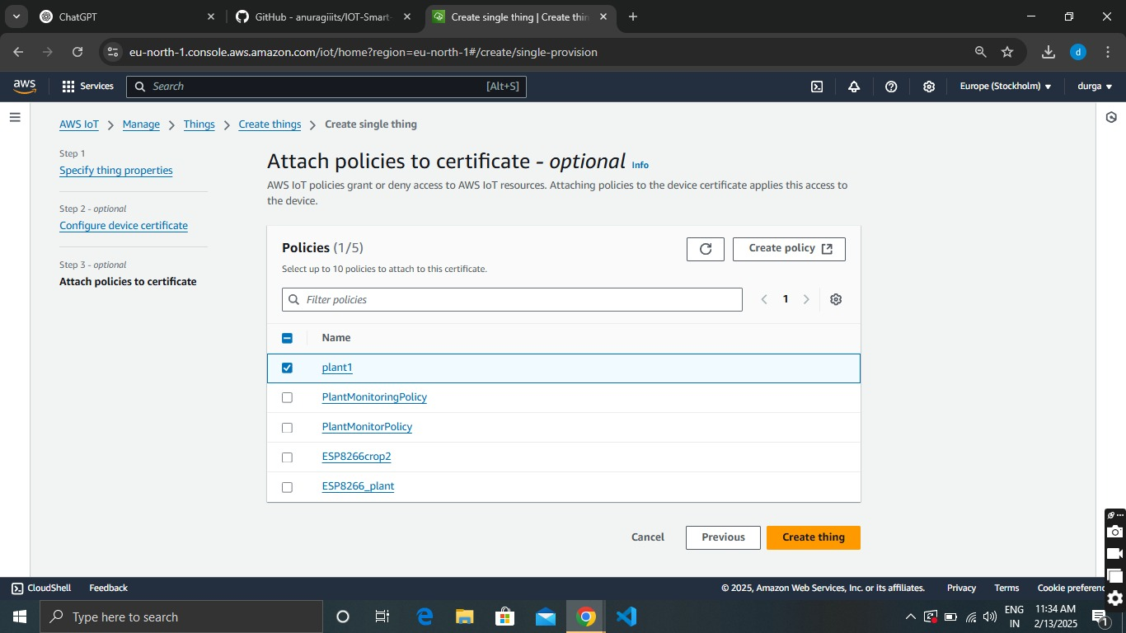
2. Attach Policies
20

Slide 21
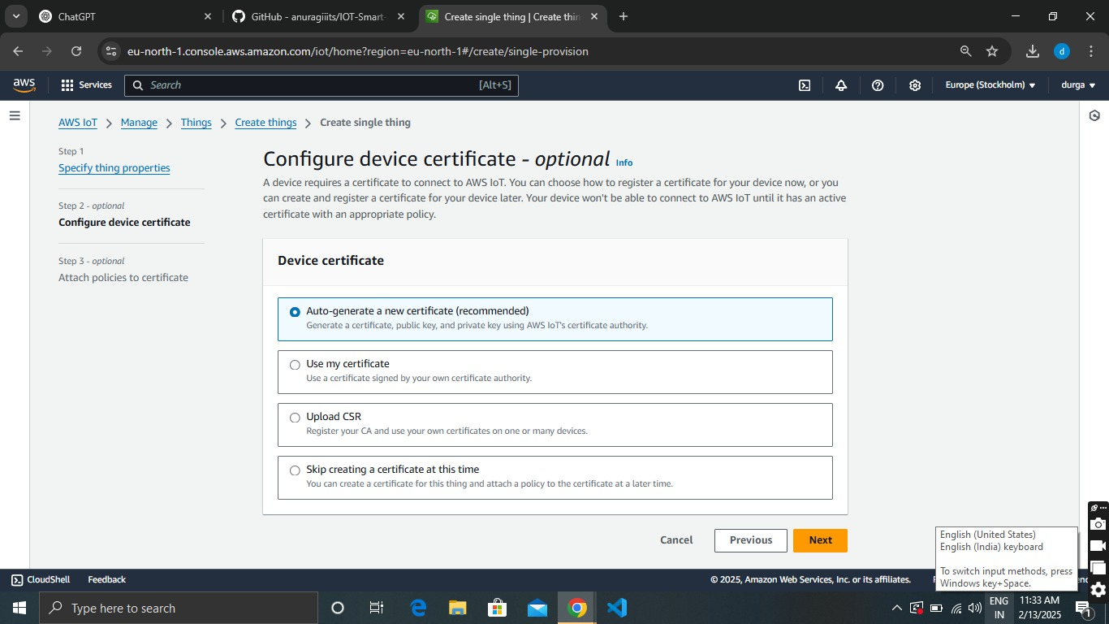
21

Slide 22
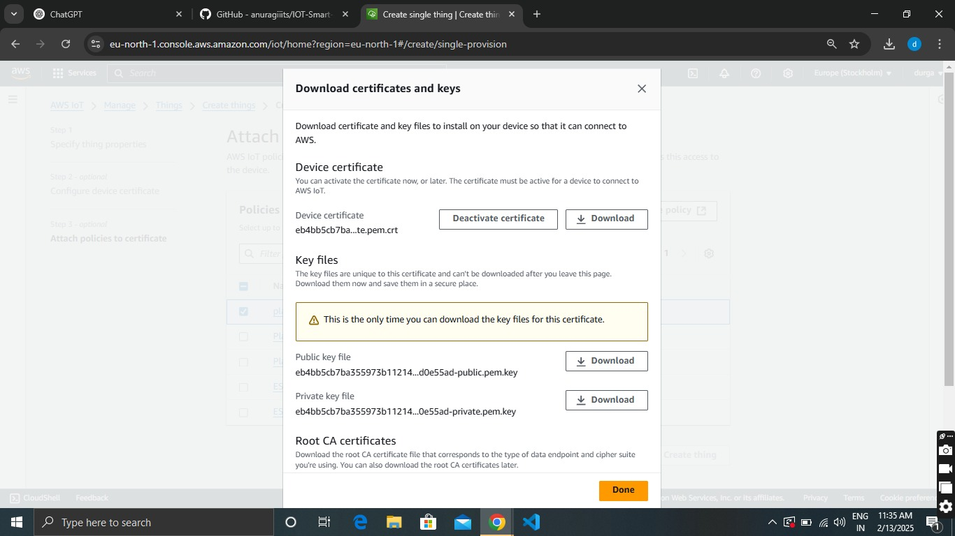
3. Download Certificates
22

Slide 23
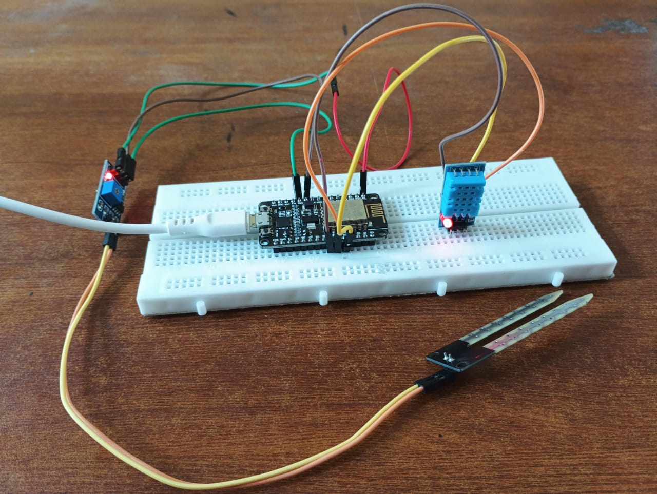
23

Slide 24
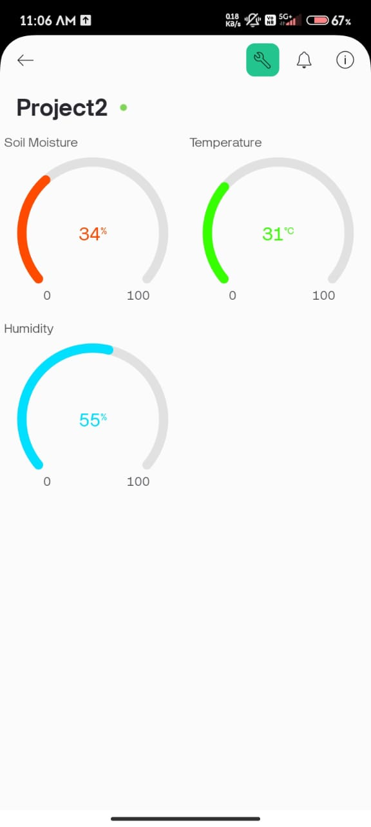
24

Slide 25
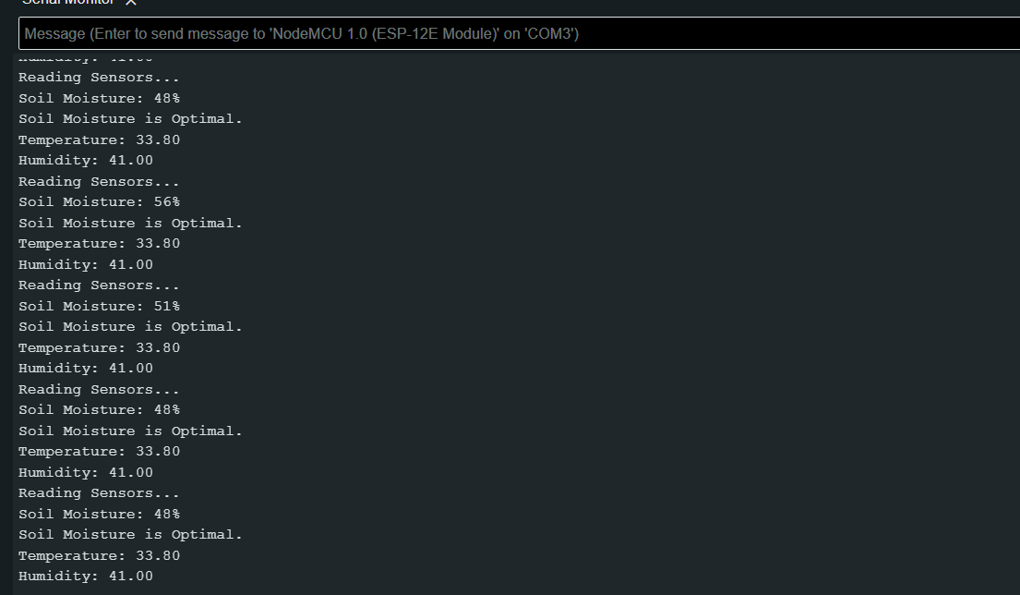

Slide 26
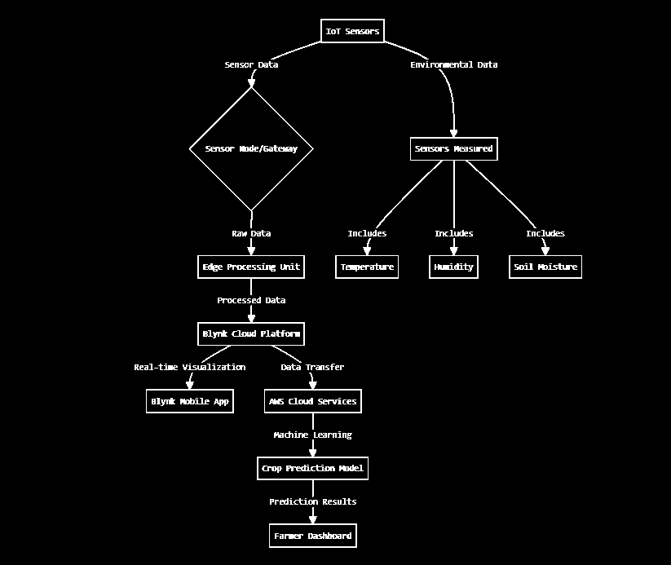
26

Slide 27
Future Enhancement:-
Integrate an automatic watering mechanism based on real-time soil moisture levels.
Include pH, light intensity, and CO₂ sensors for detailed plant health analysis.
Use AI and image processing to detect plant diseases and pests early.
27

Slide 28
Project Overview
Objective:
✅ Monitor soil moisture, temperature, and humidity in real time.
✅ Send live data to Blynk for visualization.
✅ Store and analyse data on AWS IoT Core, DynamoDB, and S3.
✅ Predict plant health using AWS Sage Maker (ML Model).
28

Slide 29
THANK YOU

